Slide 1
BATCH-B7
ONE YEAR LIFE EXPECTANCY POST THORACIC SURGERY USING IBM WATSON STUDIO

Slide 2

ONE YEAR LIFE EXPECTANCY POST THORACIC SURGERY USING IBM WATSON STUDIO
presented by :
NIMMARAJULA SUPRIYA (227Y1A67C0)
DOMBALE UMADEVI (227Y1A67C1)
GADUDASU VAISHNAVI (227Y1A67C2)
Under The Guidance Of
Ms.B.Madhavi
(Assistant Professor)
Department Of Computer Science and Engineering
(Data Science)

Slide 3
CONTENTS
Abstract
Introduction
Existing System And Proposed System
Hardware And Software Requirements
Libraries And Algorithms Used
What Is Thoracic Surgery?
Steps Involved In Thoracic Surgery
IBM Watson Studio
Results
Advantages
Conclusion And Future Implications

Slide 4
Abstract
This project aims to predict one-year life expectancy after thoracic surgery using machine learning techniques.
The dataset includes important clinical and lifestyle features such as pain, cough, smoking habits, and asthma. These factors were analyzed using models like Logistic Regression, Decision Tree, Random Forest, and Naïve Bayes. Among them, Logistic Regression achieved the highest accuracy of 85%.
To enhance prediction performance, feature selection and attribute ranking were applied to identify the most influential factors.
The study demonstrates how machine learning can support medical professionals in assessing post-surgical risks and improving treatment decisions. Additionally, deep neural networks show promise for achieving even higher accuracy in future applications.

Slide 5
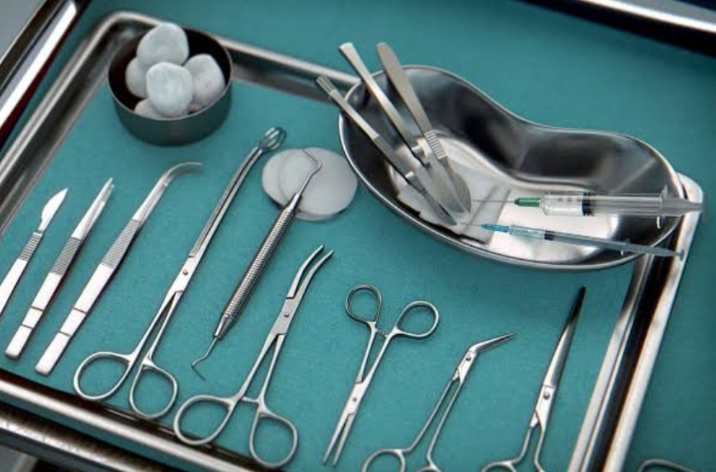
Introduction
The introduction of computer applications into the medical industry has had a direct impact on doctors productivity and accuracy in recent years.
One of these applications is the study of health outcomes. In most nations, cancer is now one of the leading causes of mortality.
Thoracic surgery is the most common operation performed on lung cancer patients.
Massive datasets of cancer have been collected and made available to medical professionals as a result of the advancement of new tools in the field of medicine.
Many machine learning techniques such as KNN, Logistic regression, random forest etc...are used to predict life expectancy for post thoracic surgery…..

Slide 6
EXISTING AND PROPOSED SYSTEM
EXISTING SYSTEM
PROPOSED SYSTEM
1. Manual data collection and analysis.
2. Limited predictive capabilities.
3. Lack of real-time patient monitoring.
4. Inefficient resource allocation.
5. Limited collaboration among healthcare professionals.
1.Automated data collection and analysis.
2. Enhanced predictive analytics for better patient outcomes.
3. Real-time monitoring of patient vital signs.
4. Optimal resource allocation through AI-driven recommendations.
5. Improved collaboration among surgeons and medical staff through data sharing and insights.

Slide 7
Hardware and software requirements
Hardware requirements
Software requirements
System : Intel CORE i5
Hard disk : 2 TB
Screen : 15VGA colour
Ram : 16GB
Operating system : windows 11
Dataset : CSV file, TSV file
Programming Language : python
IDE: Jupiter, Python 3.7,google collab

Slide 8
LIBRARIES AND ALGORITHMS USED
ALGORITHMS USED
LIBRARIES USED
KNN – accuracy 81%
Random Forest – 83%
Logistic Regression – accuracy 85%
we got the highest accuracy in predicting the problem using logistic regression when compared to other algorithms.
Numpy
Pandas
Seaborn
Matplotlib
sklearn

Slide 9
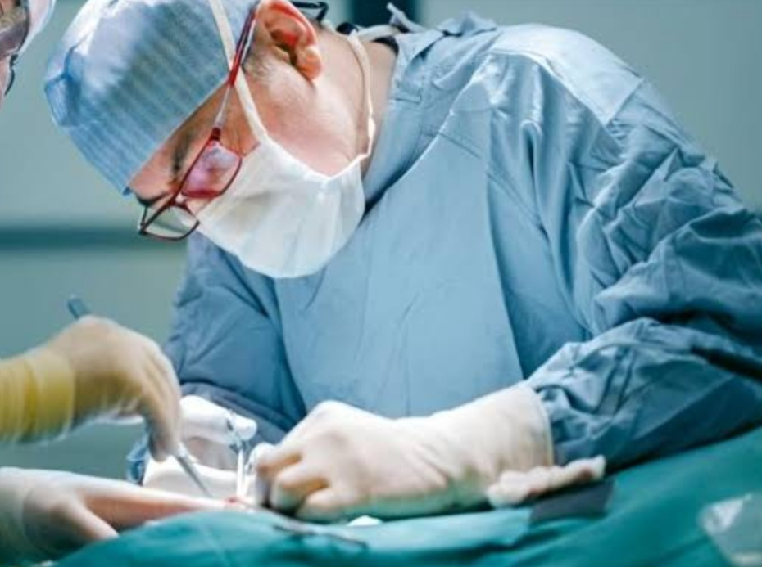
What is thoracic surgery?
Thoracic surgery refers to the treatment of organs within the chest, including the lungs, heart diseases.
Importance: Thoracic surgery is often used to treat life-threatening conditions such as lung cancer, heart disease and cancer.
Challenges: Thoracic surgery is a complex and challenging field that requires a high degree of skill, training, and expertise.
Thoracic surgeons, also known as cardiothoracic surgeons, are highly trained medical professionals who perform a wide range of procedures.

Slide 10
Steps in thoracic surgery
Step 1: Collect and Prepare Data
Collect and prepare patient data from various sources, including electronic health records, lab test results, and medical images.
Step 2: Analyse Data
Use IBM Watson Studio to analyse patient data and identify risk factors that may affect one-year expectancy.
Step 3: Predict Outcomes
Use IBM Watson Studio to predict long-term patient outcomes based on the analysis of patient’s data
Step 4: Optimize Surgical Procedures
Use the insights gained from IBM Watson Studio to optimize surgical procedures for better patient outcomes.
Step 5: Monitor Post-Surgical Outcomes
Use IBM Watson Studio to monitor post-surgical outcomes and adjust treatment plans as needed

Slide 11
IBM Watson Studio
IBM Watson Studio is an advanced analytics platform that helps organizations build and deploy AI models and applications.
What are the benefits of using IBM Watson Studio?
IBM Watson Studio allows for faster development and deployment of AI models and provides advanced analytics capabilities.
Improved Patient Outcomes
Increased Efficiency
Reduced Healthcare Costs

Slide 12
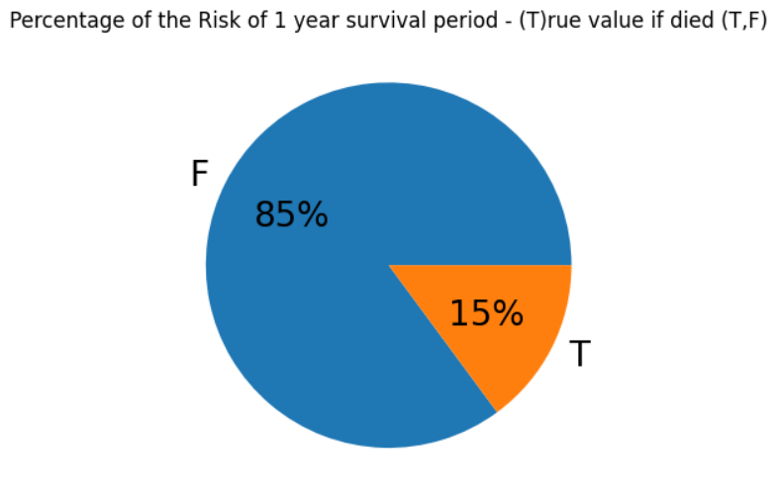
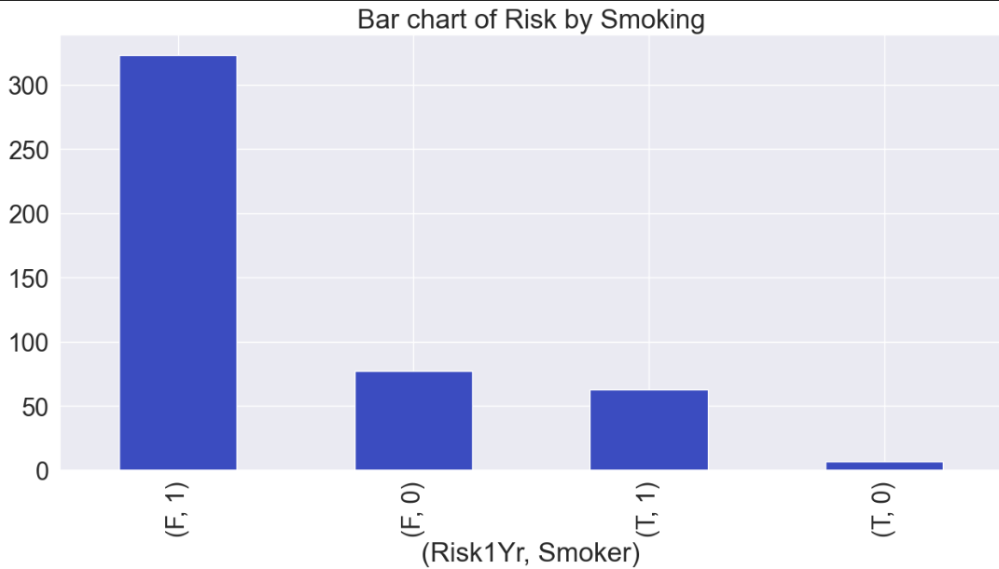
Results

Slide 13
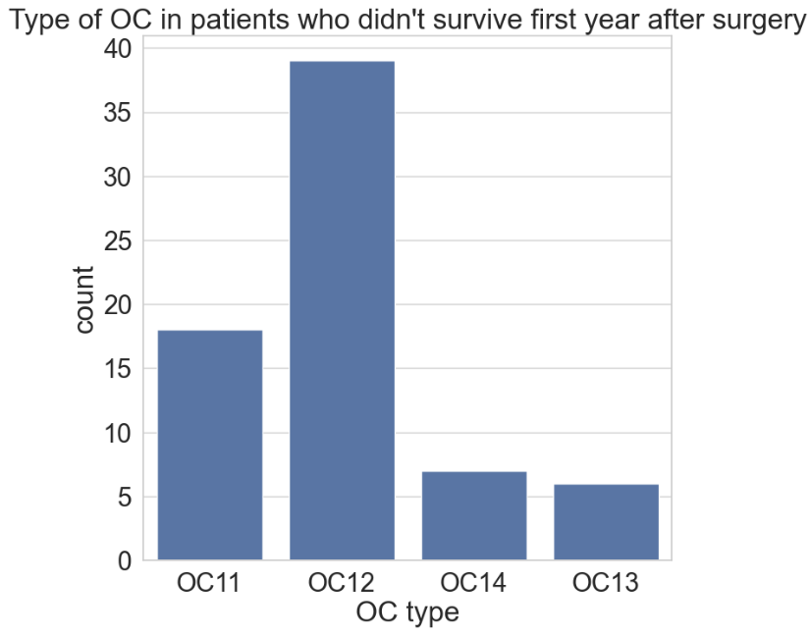
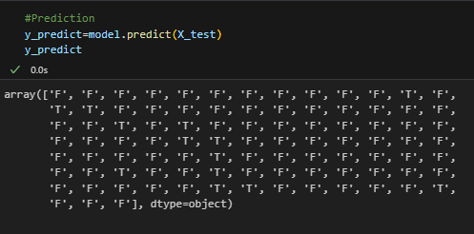

Slide 14
Advantages
Better Survival Prediction
Helps in Decision Making
Personalized Patient Care
Saves Time and Resources
Uses Automation
Tests Different Algorithms
Can Be Used in Other Areas

Slide 15
Conclusion and future implications
This project shows how machine learning can help predict whether a patient will survive one year after thoracic surgery. By using patient data and models like Logistic Regression, we can support doctors in making better decisions. IBM Watson Studio made it easy to build, test, and improve these models. This helps improve patient care, save time, and reduce risks after surgery.
Future Scope
This project can be expanded to other surgeries like heart or brain operations.
More patient data can improve model accuracy even further.
Deep learning techniques can be added for better predictions.
Real-time hospital systems can use this model to help doctors instantly.
The same method can help in predicting recovery time or chances of complications.

Slide 16
THANK YOU

